Slide 1
Cisco Meraki
DEVWKS-1117
Cory Guynn, API Product Management Architect
Mastering Webhook Alerts & Callbacks

Slide 2


Agenda
Introduction
Meraki Alerts & Webhooks
Webhook Payload Templates
Included and Custom Integrations
Callbacks
Lab

Slide 3
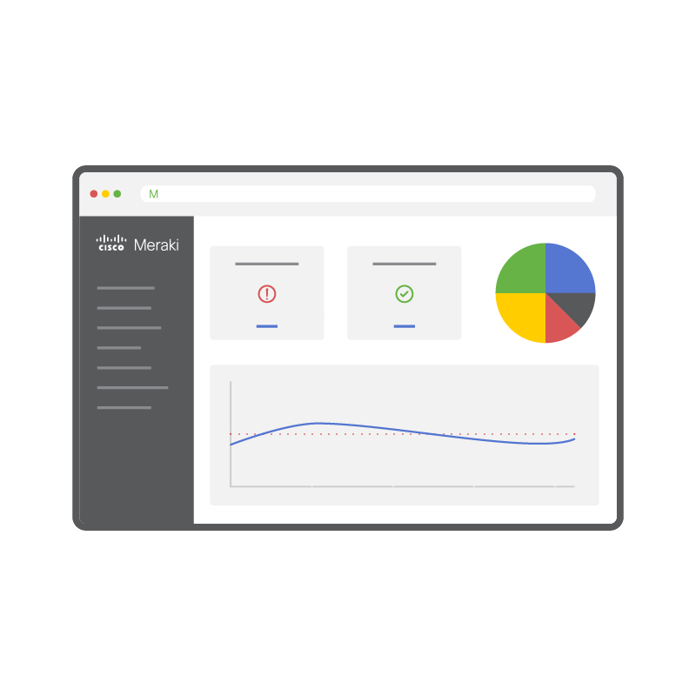
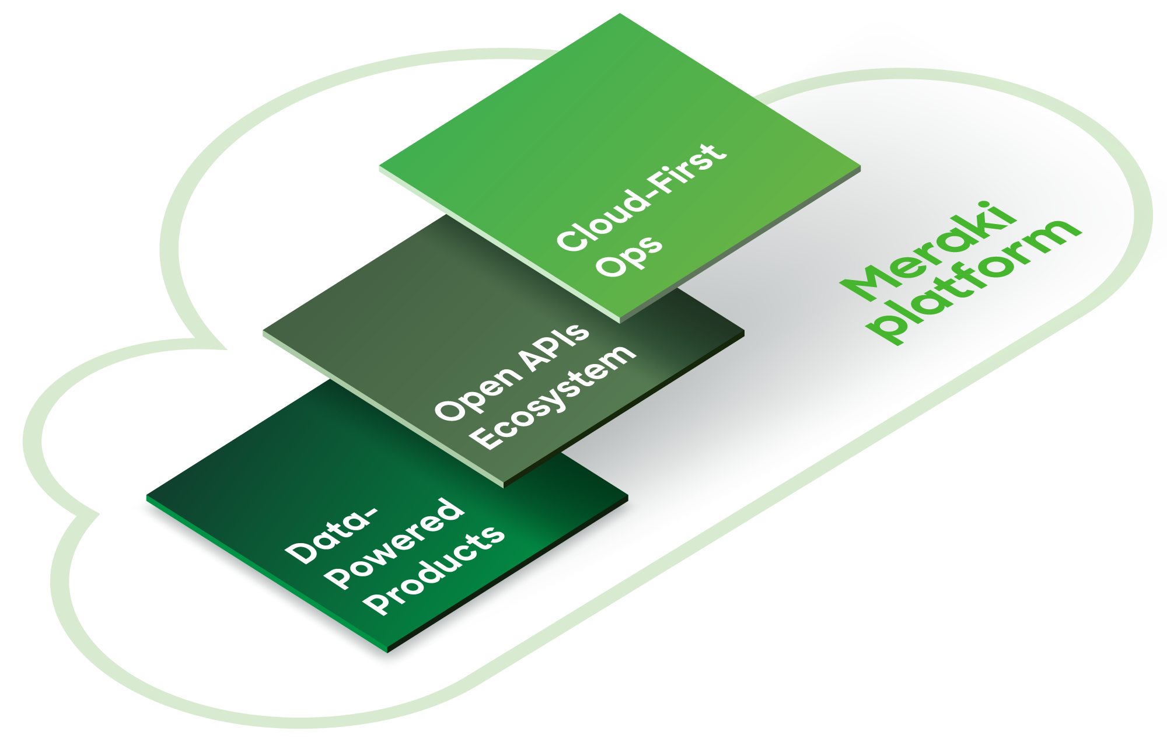


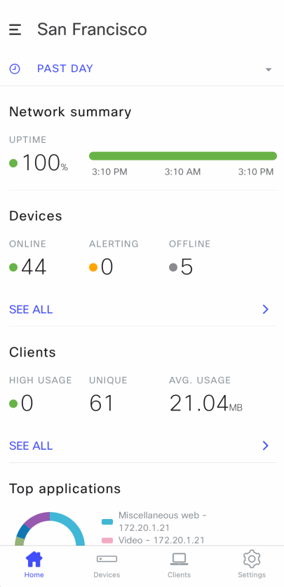

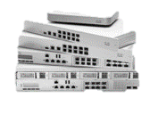






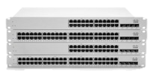
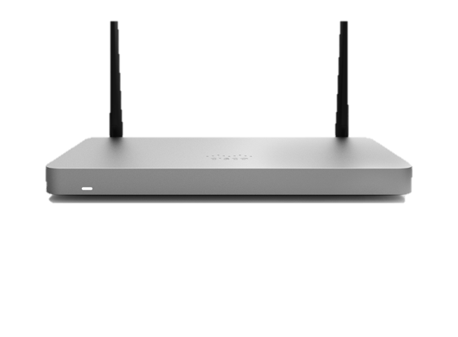
The Meraki Platform:
A foundation for IT and IoT transformation
CUSTOM BUILT
developer.cisco.com/meraki
API
Built-in solutions
Tailored solutions
TECH PARTNERS
meraki.com/marketplace
MERAKI DASHBOARD
Wireless
Switching
Mobile device management
Security and SD-WAN
Cellular gateways
Smart cameras
Sensors
ACCESS
SECURITY AND IOT

Slide 4
Meraki API

Slide 5
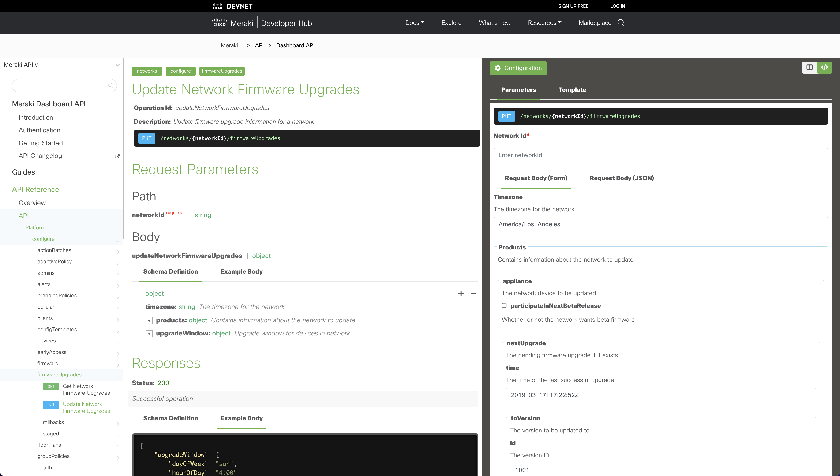
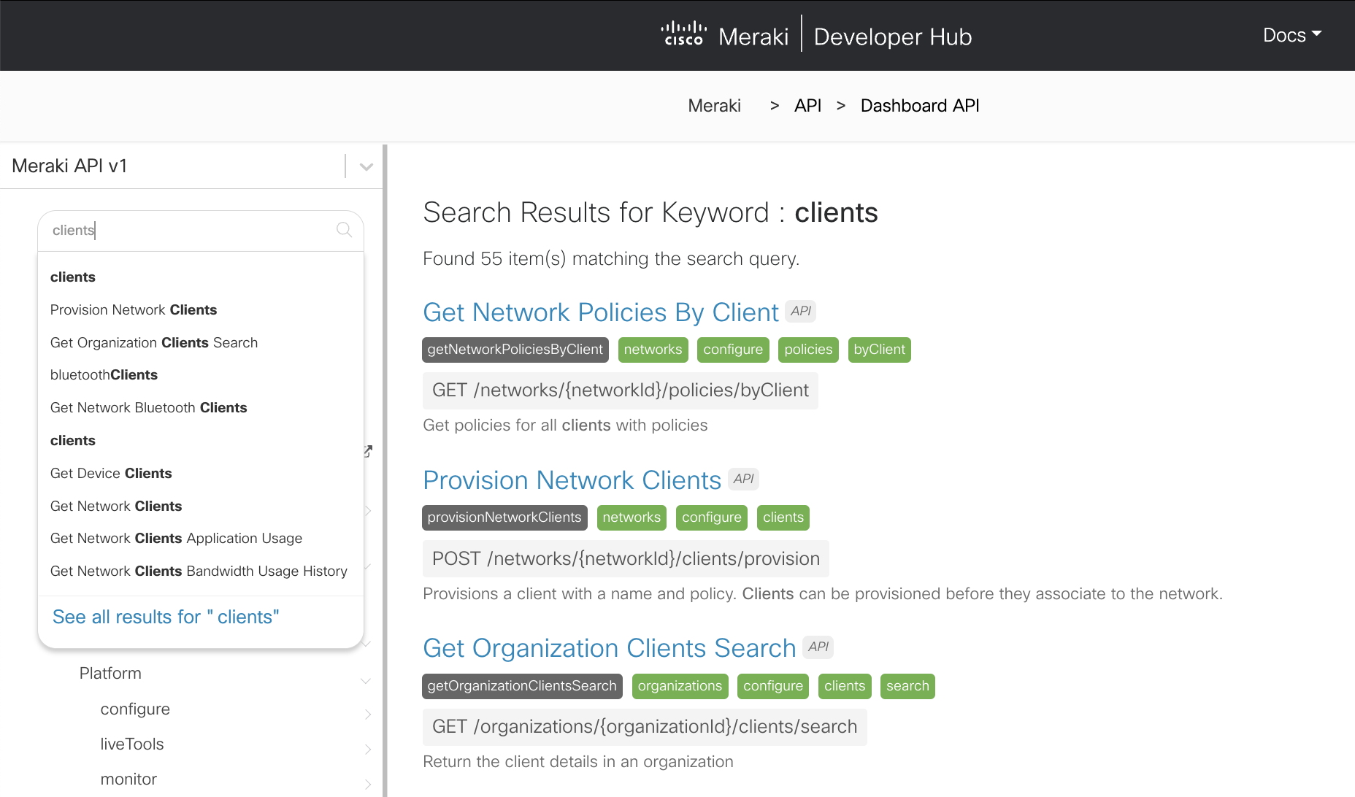
Meraki.io
Interactive API Docs
Sample Code
Guides & Labs
Built on the OpenAPI

Slide 6
Webhooks

Slide 7
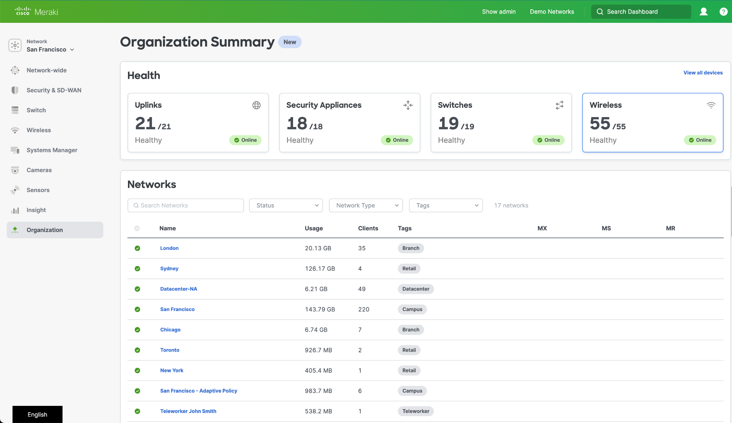
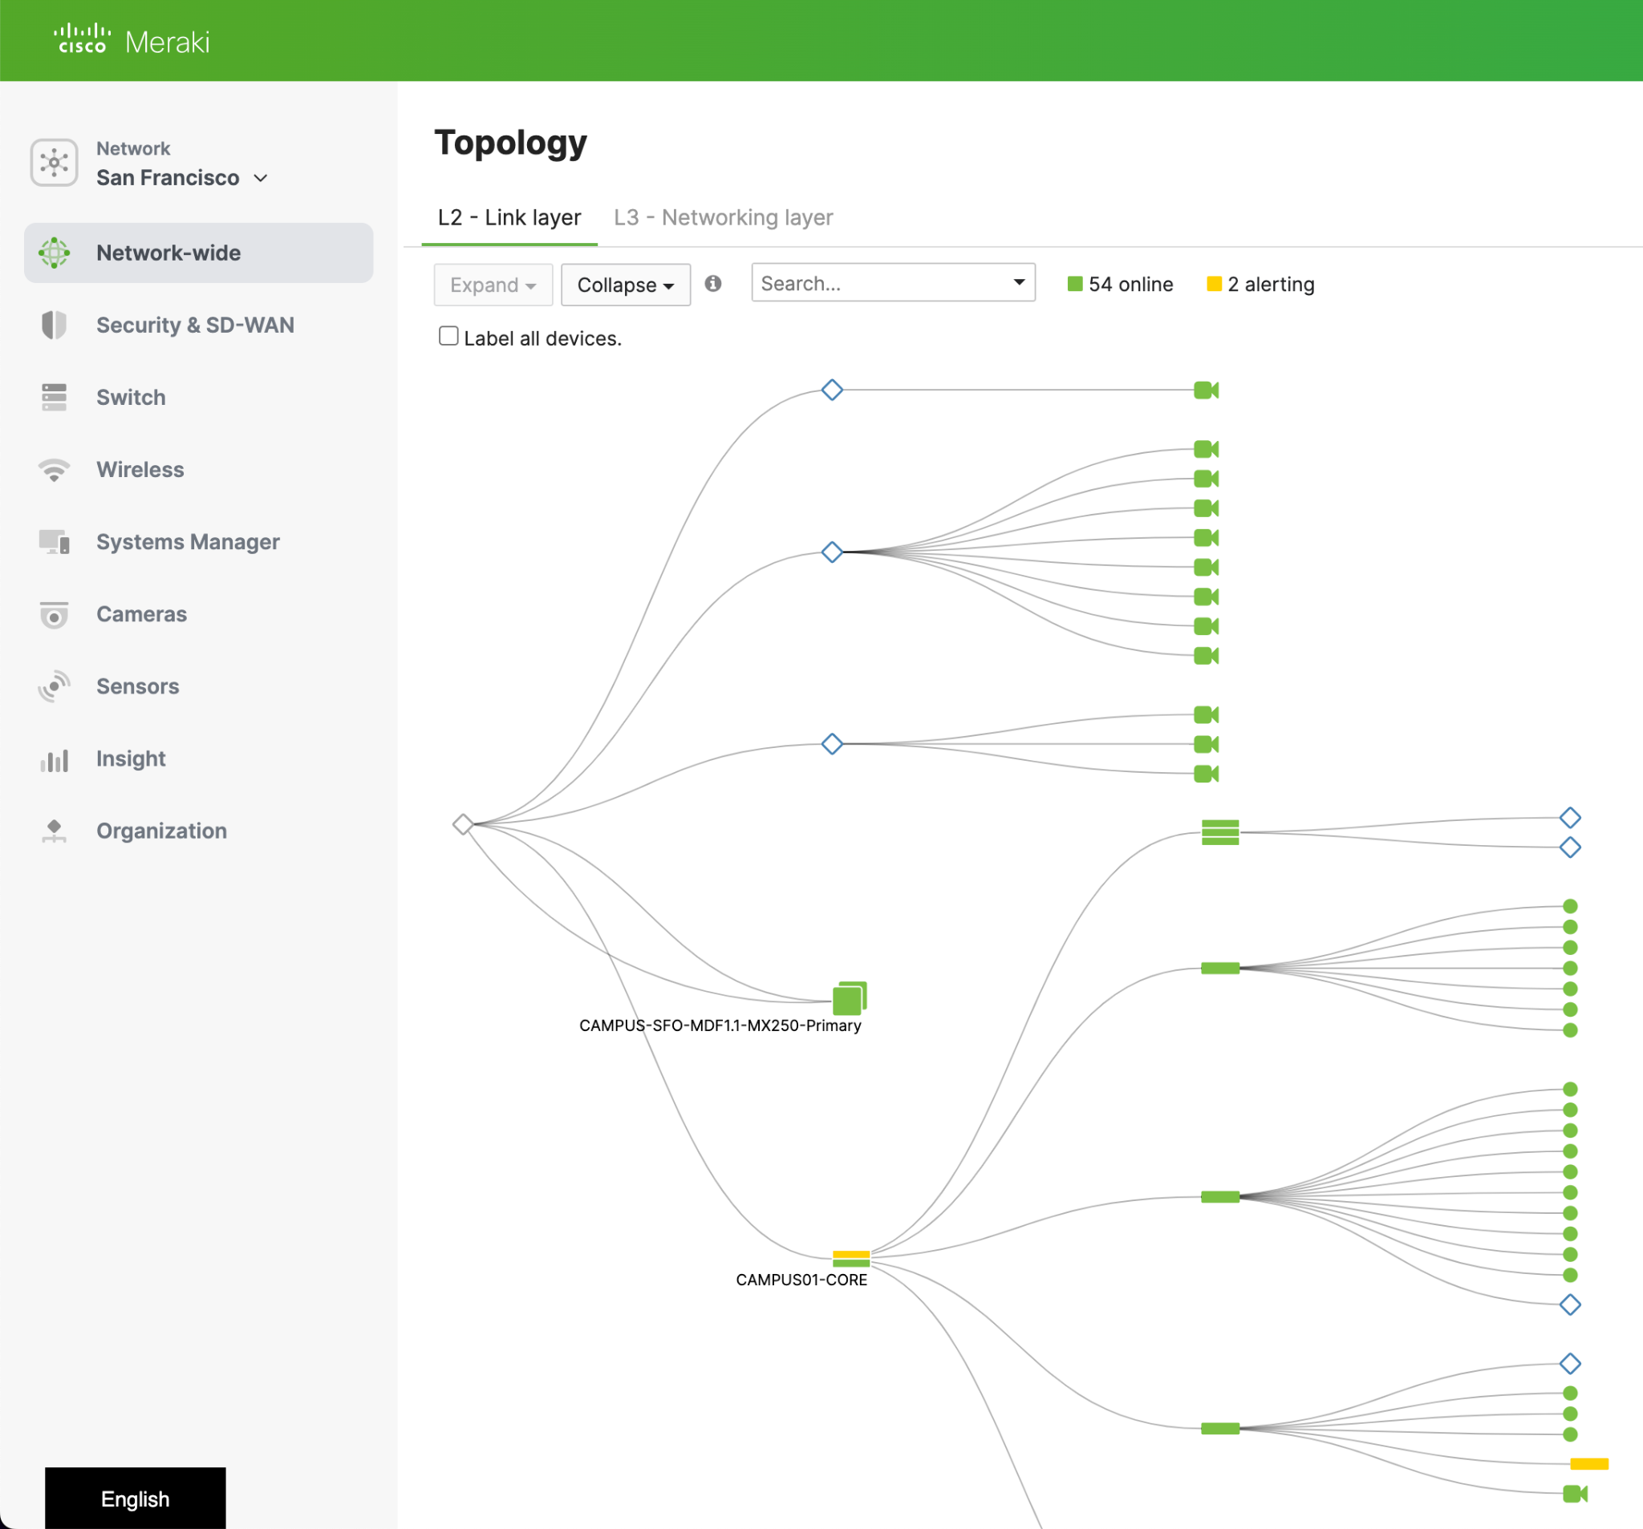
Cisco Meraki Dashboard
Single pane of glass to manage…
Wireless access points
Network switches
Security Appliances
Cameras
Sensors
Notes:
Meraki Dashboard / Intro

Slide 8
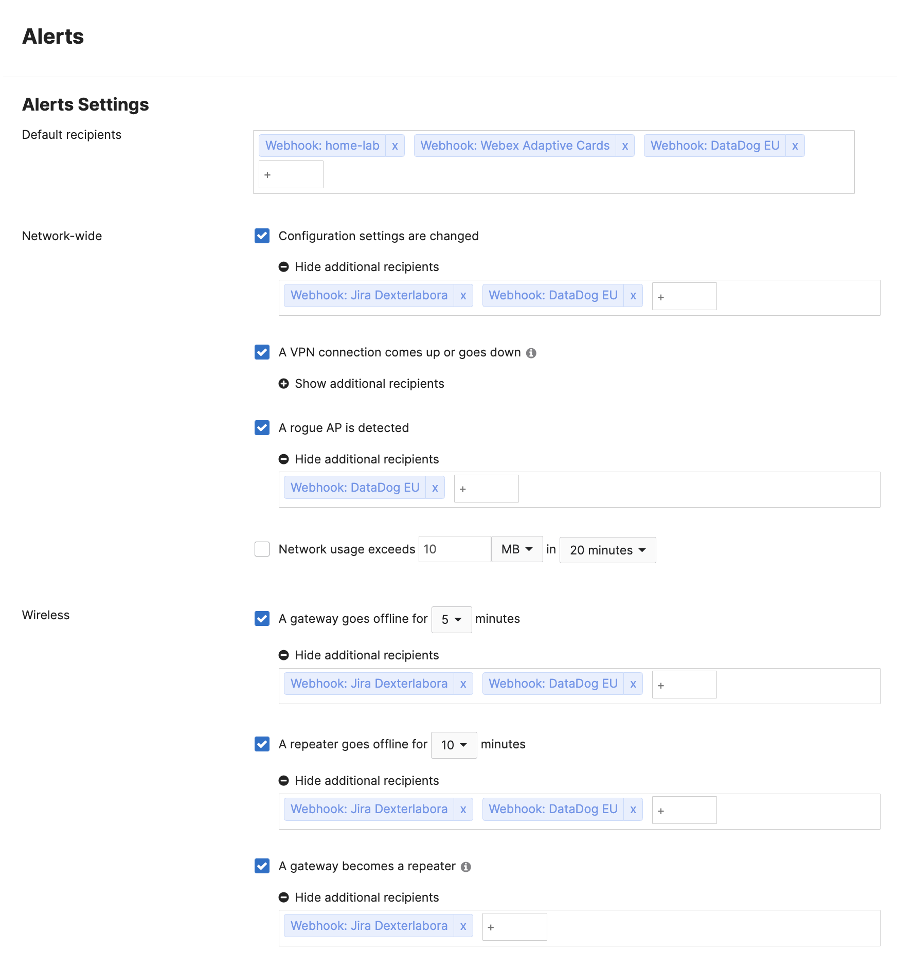
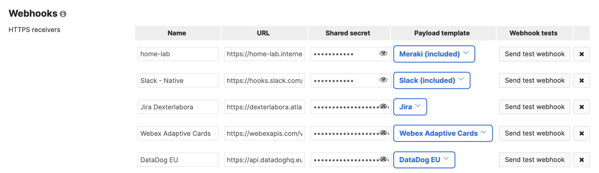

Network Alerts
Alerts are network events that are sent to admins and services when something changes with your environment.
e-mail
SMS
webhook
Notes:
Monitoring with Alerts (so that you don't have to watch the dashboard 24/7)

Slide 9
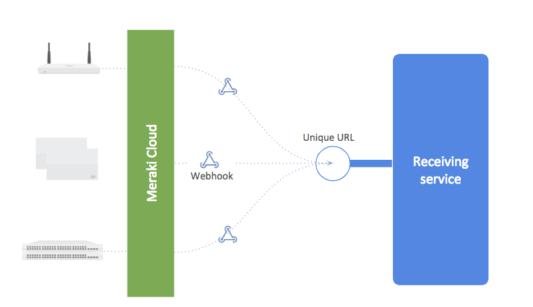
What are Webhooks ?
They are event driven outbound API requests
HTTP Request (POST https://webexapis.com/v1/webhooks/incoming/..)
X
Alert
X
IP conflict
AP offline
X
motion detected
Meraki
https://myserver/events
Notes:
Webhooks 101

Slide 10

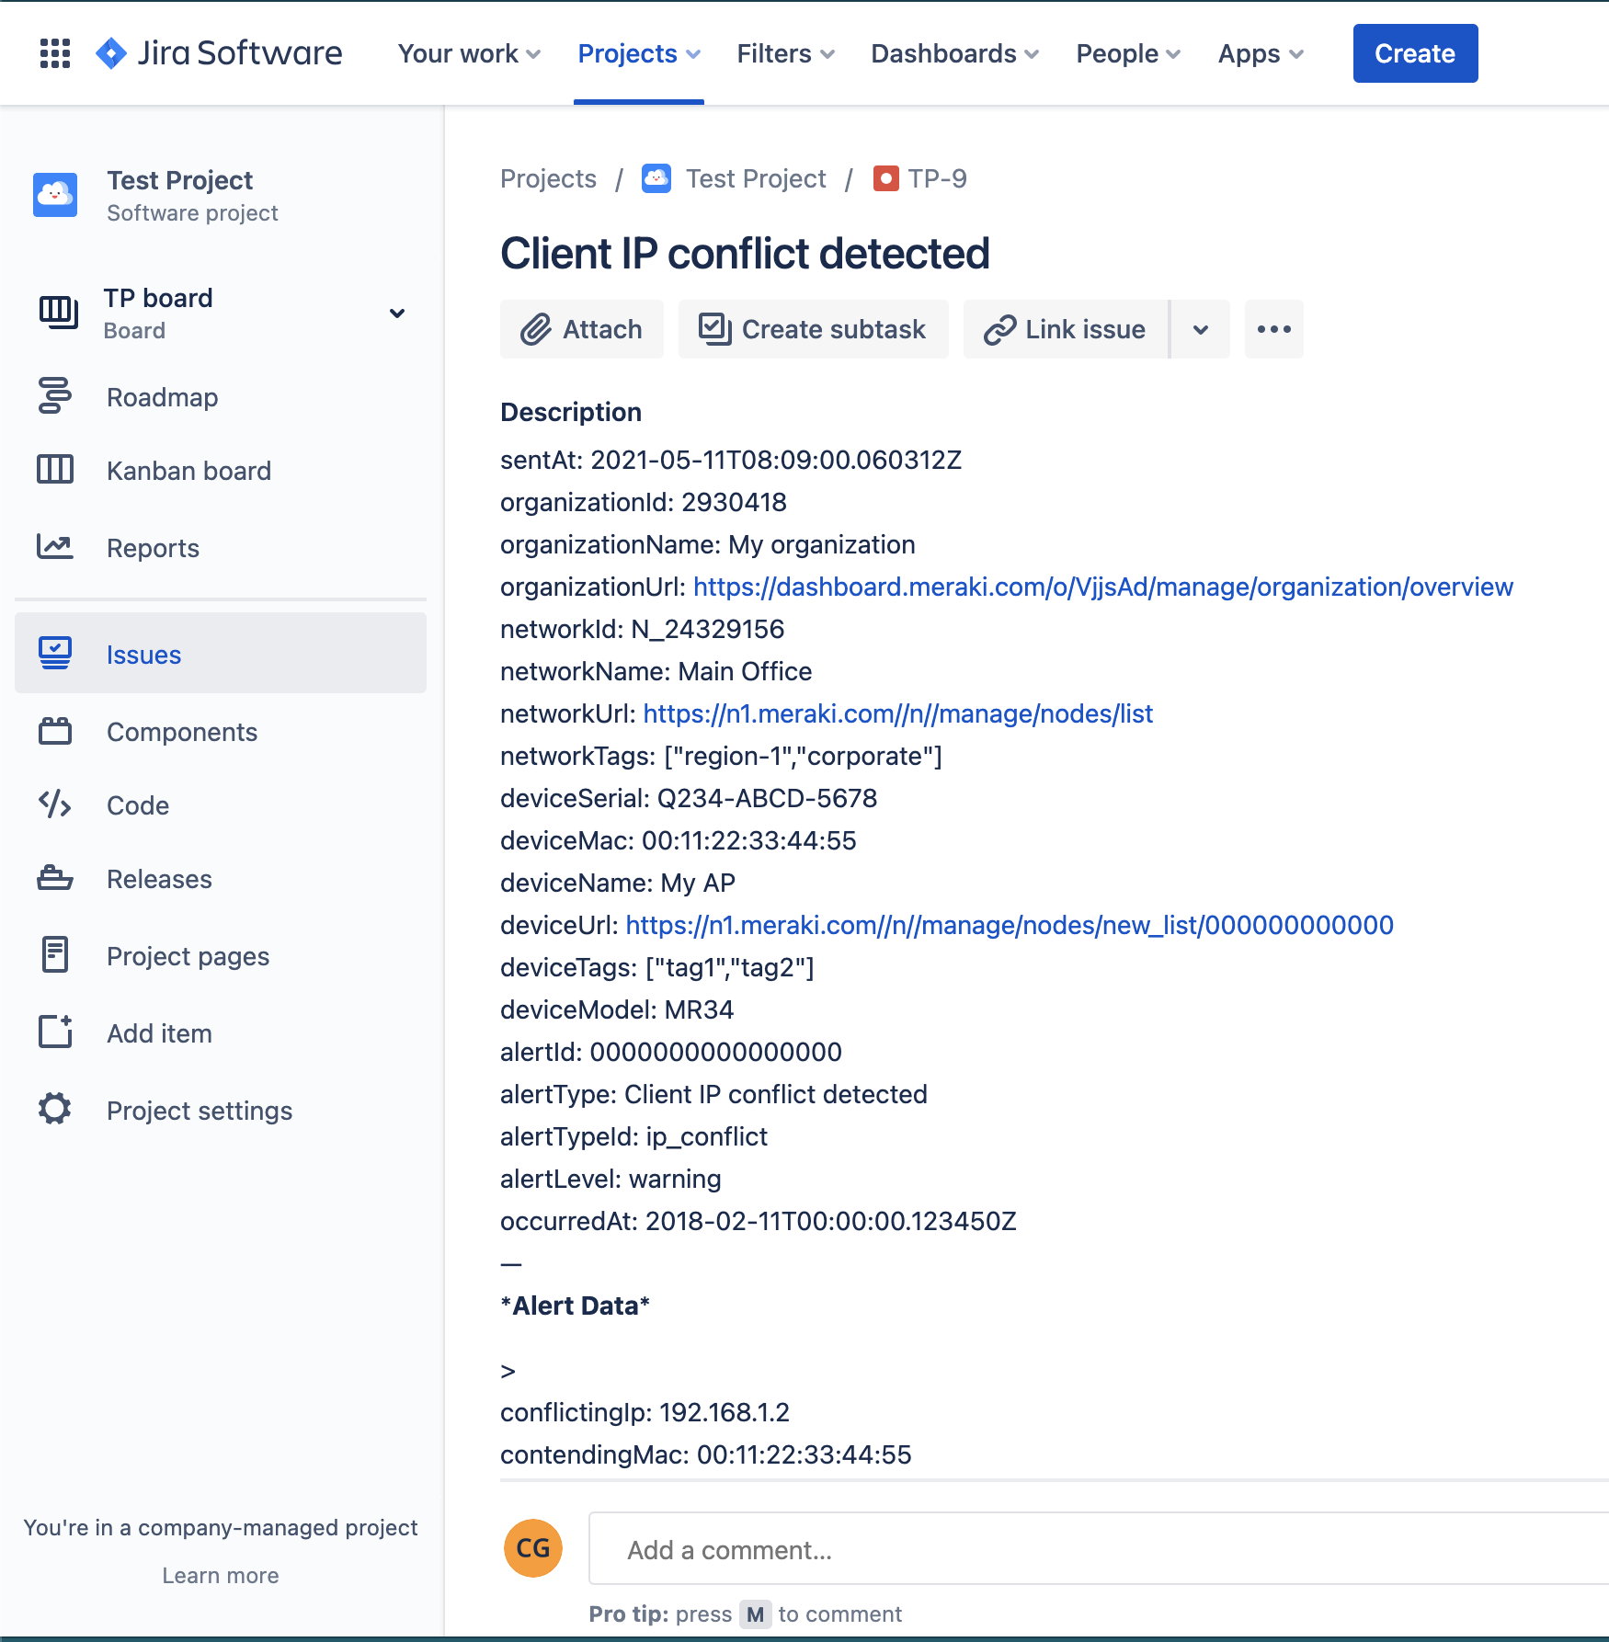

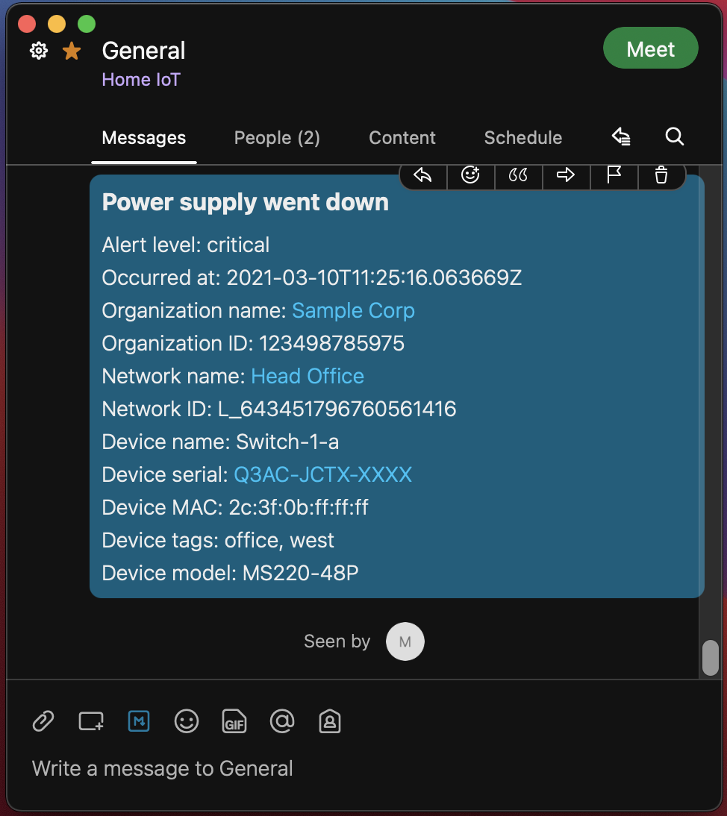
Webhooks
Send Meraki alerts to other services automatically
Use a webhook template to interface with 3rd party APIs
Integrations made simple
Messaging
Monitoring
Logging
IoT
​ Meraki.io/webhooks

Slide 11










Webhook Integrations
Available at: https://github.com/meraki/webhook-payload-templates
Notes:
Having all the customers networking on Meraki means only 1 place the alerts will be generated from. But customers will have many different vendors for all of their IT requirements that they must also monitor.
Payload Templates enable the webhook data to be shaped as desired and sent directly to the destination API, without any additional services in between allowing direct integration
Meraki customers can now import alerts into Slack, WebEx, Microsoft teams, service now within Dashboard.
This integrations are build by API team using a technology we call Webhook Payload Templates. This technology is open to customers and developers. That means,
1/ there are a myriad of other templates (built and maintained by the developer community) that customers can use like Jira, DataDog, PagerDuty, Discord and Splunk
2/ customers can build their own templates and start importing meraki alerts into their platform of choice today.
AlertMagic - an alert aggregation service, based out of the UK
https://github.com/meraki/webhook-payload-templates/tree/main/alertmagic
Discord - a popular VoIP and text messaging service
https://github.com/meraki/webhook-payload-templates/tree/main/discord
Splunk
unified security and observability platform gives end-to-end visibility, rapid investigation and action and platform extensibility

Slide 12
Quick Start

Slide 13
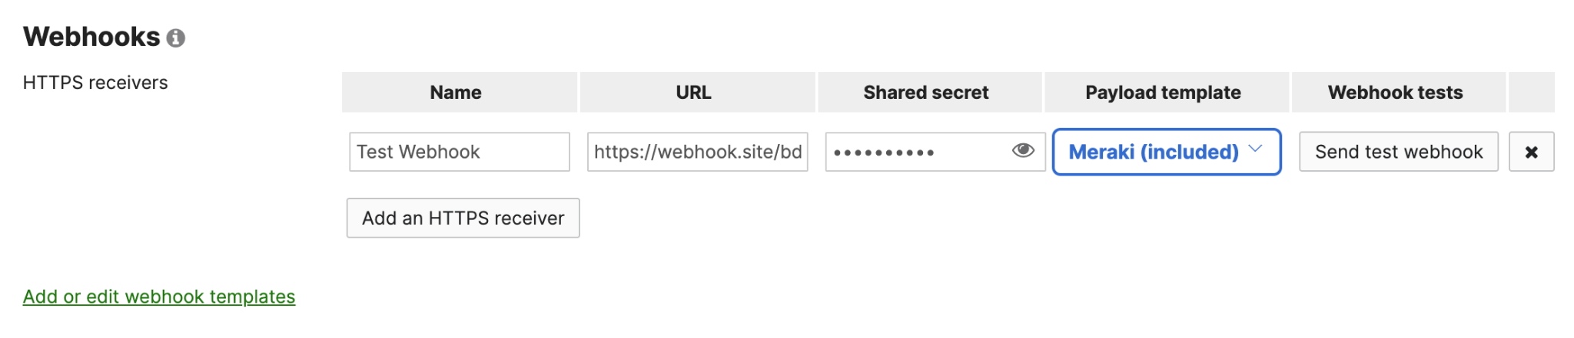
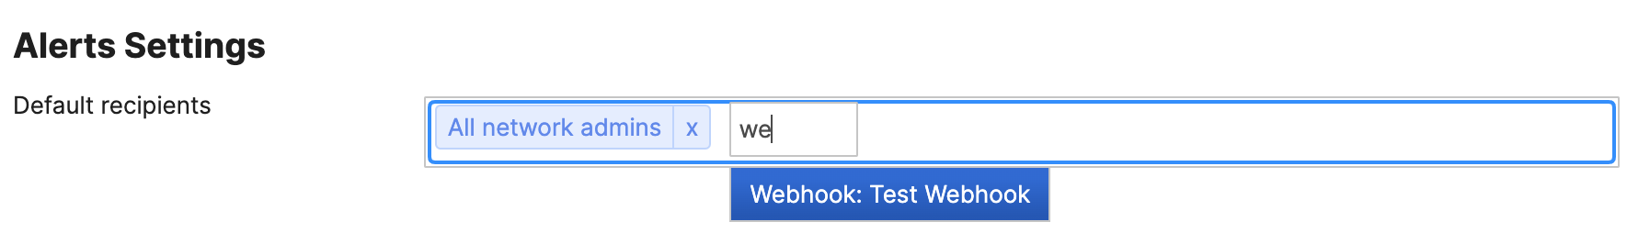
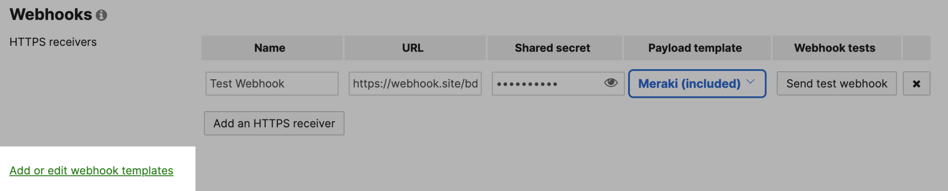
Configuring a Webhook
Meraki Dashboard → Network-wide → Alerts
Add a Webhook HTTPS receiver
Assign the webhook as a recipient for alerts
Add or edit webhook templates
Notes:
Use the network wide alerts page to configure webhooks and templates (this is the classic method) Use organization Webhooks & Alerts for the new method

Slide 14
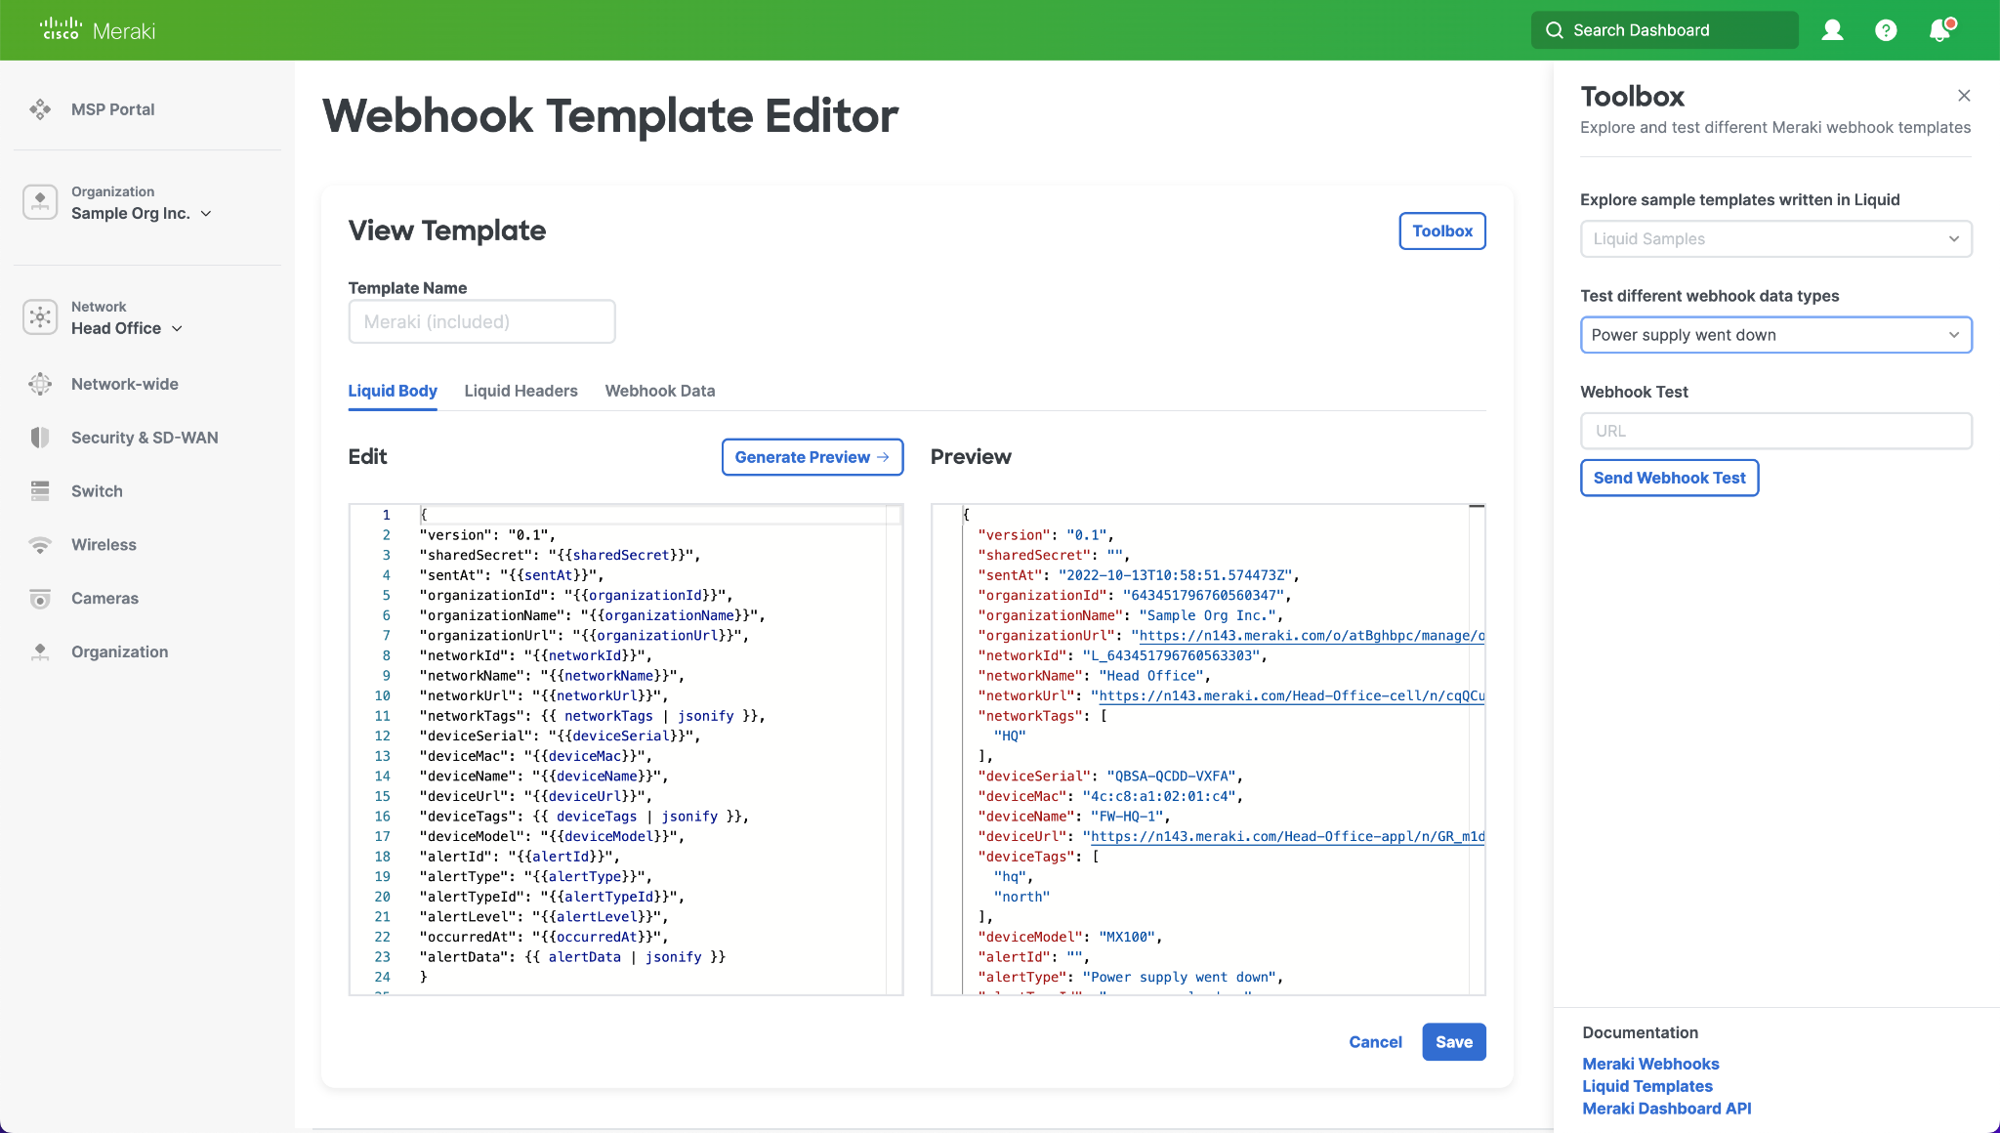
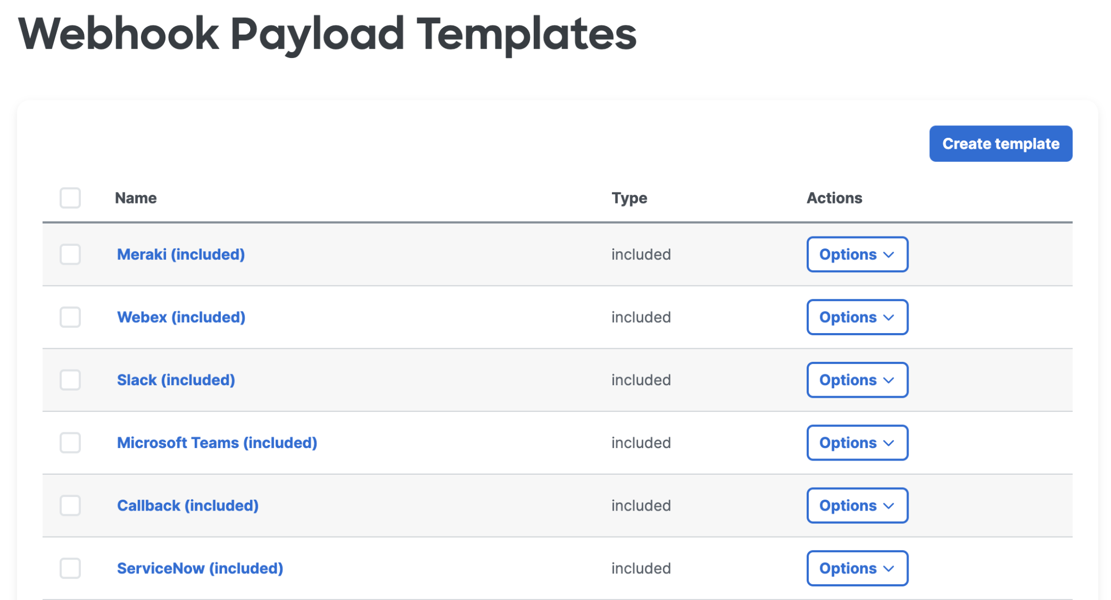
Configuring Webhook Templates
View and Edit webhook templates
Preview the results with different alert types
Send a test to a webhook receiver URL
Select an existing template or create a new one to open the editor.

Slide 15
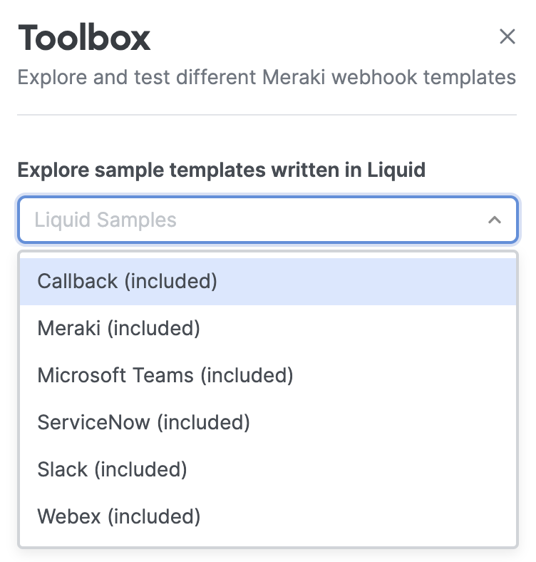
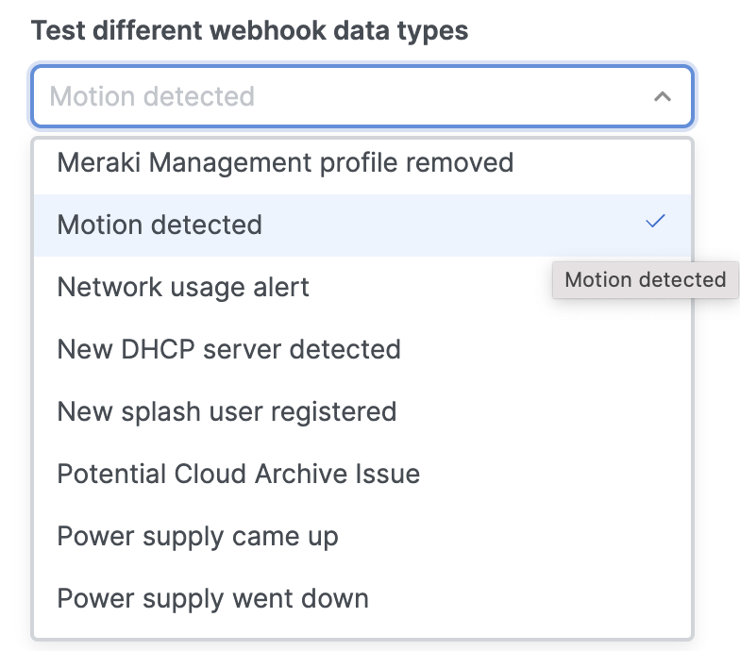
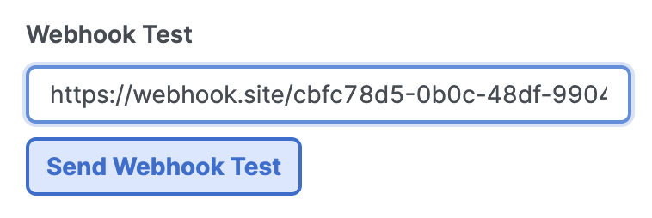
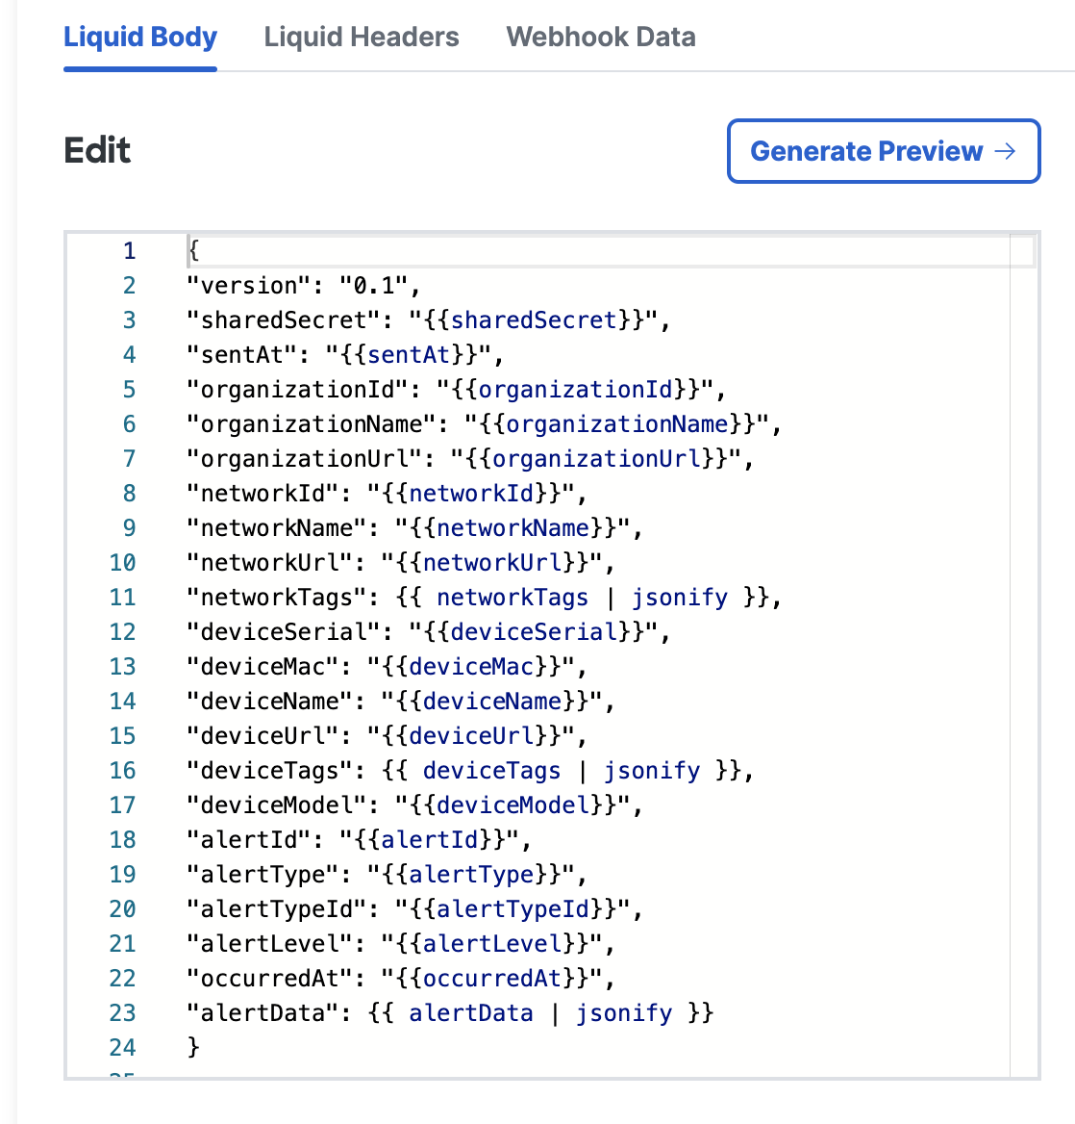
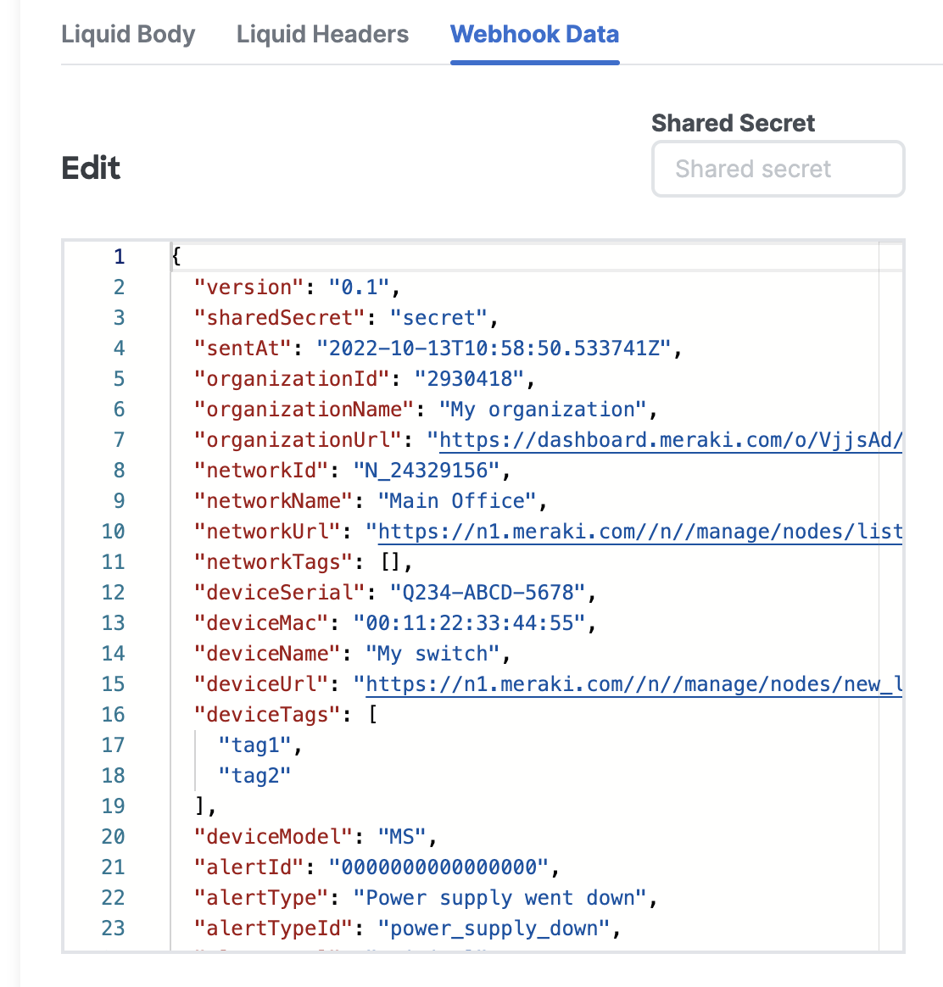
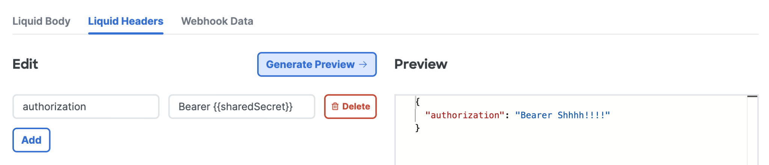
Webhook Template Editor
Test the templates end-to-end
Liquid Body allows to you to write custom formatted JSON
Liquid Headers allow you to write your own authentication requirements
Webhook Data enables you to understand what name/values are in the JSON

Slide 16
Example Integrations

Slide 17
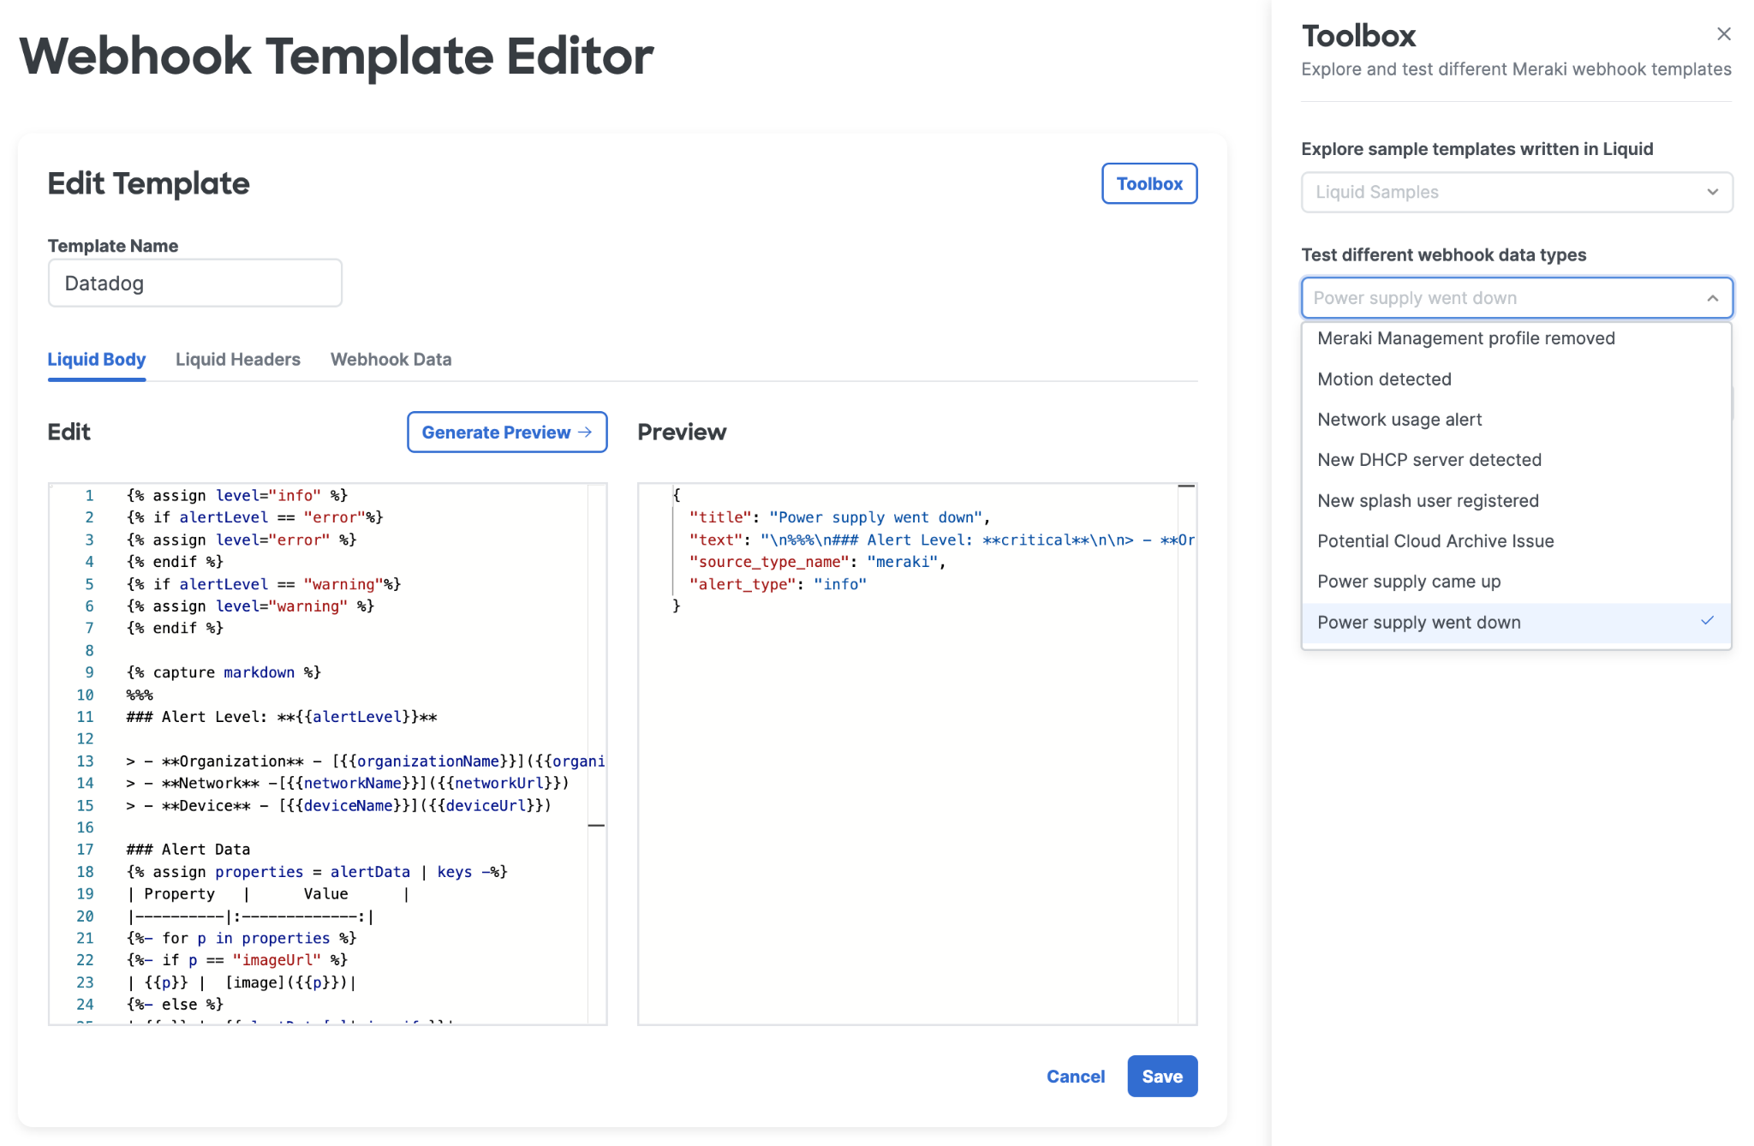
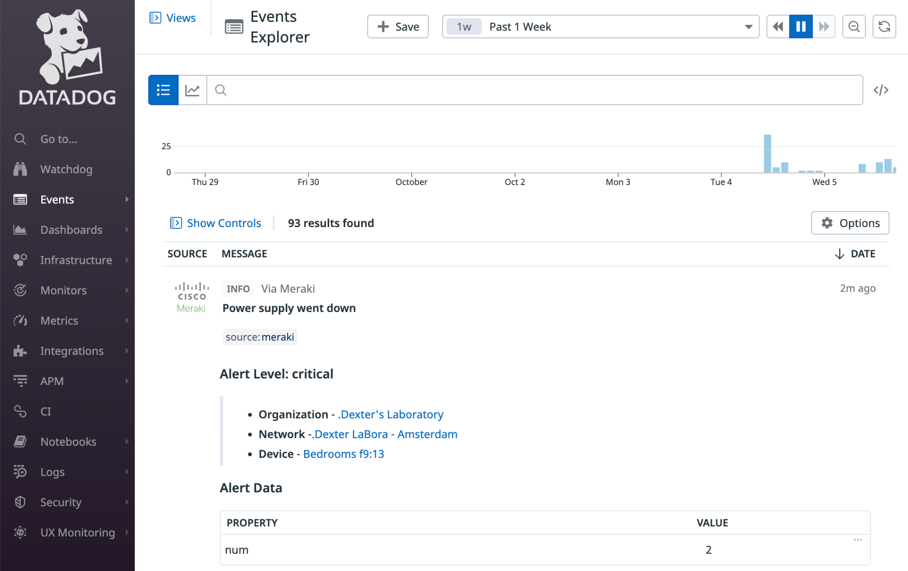
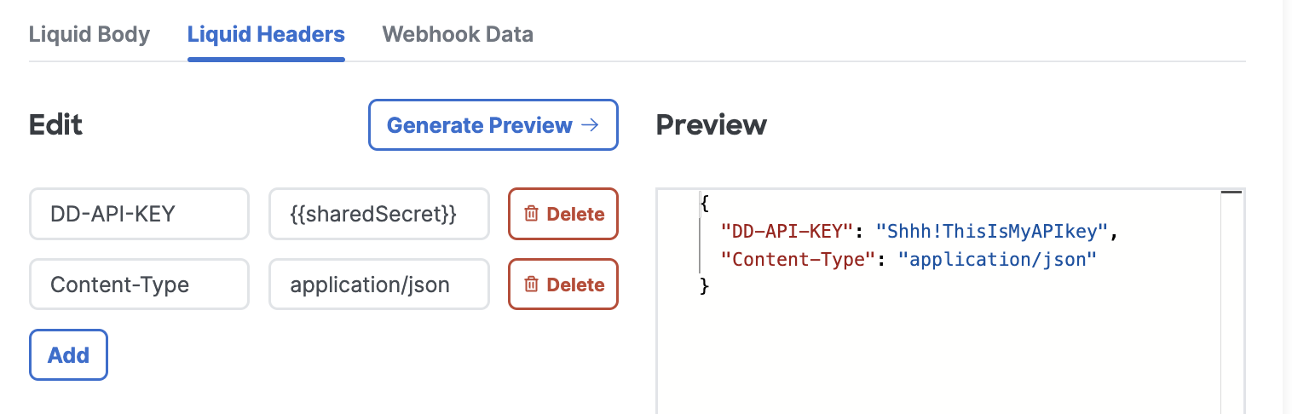
Webhooks + Datadog
Custom template with the Datadog /events API
Capture Meraki Alerts easily
Get this webhook template from the GitHub repository.

Slide 18
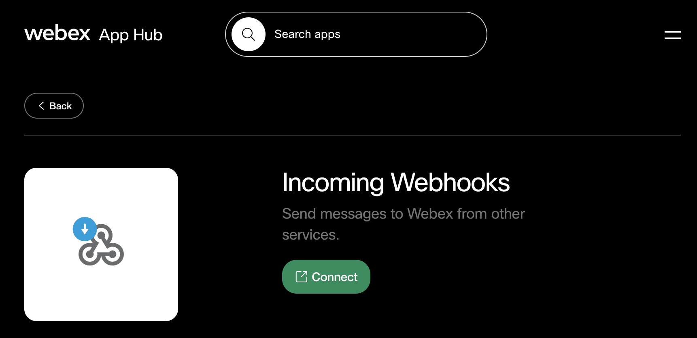
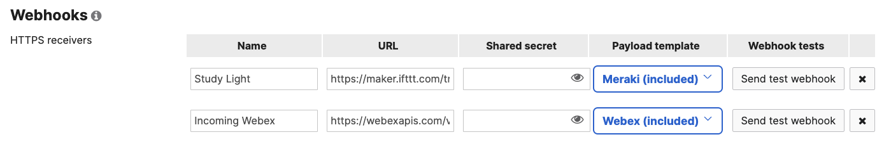
Webhooks + Webex
1
Enable Incoming Webhooks
2
Configure Meraki Webhook & Select “Webex” template
3
Meraki Alerts to your Webex space!
Notes:
https://developer.cisco.com/meraki/webhooks/#!webex-included
https://apphub.webex.com/applications/incoming-webhooks-cisco-systems-38054-23307-75252

Slide 19
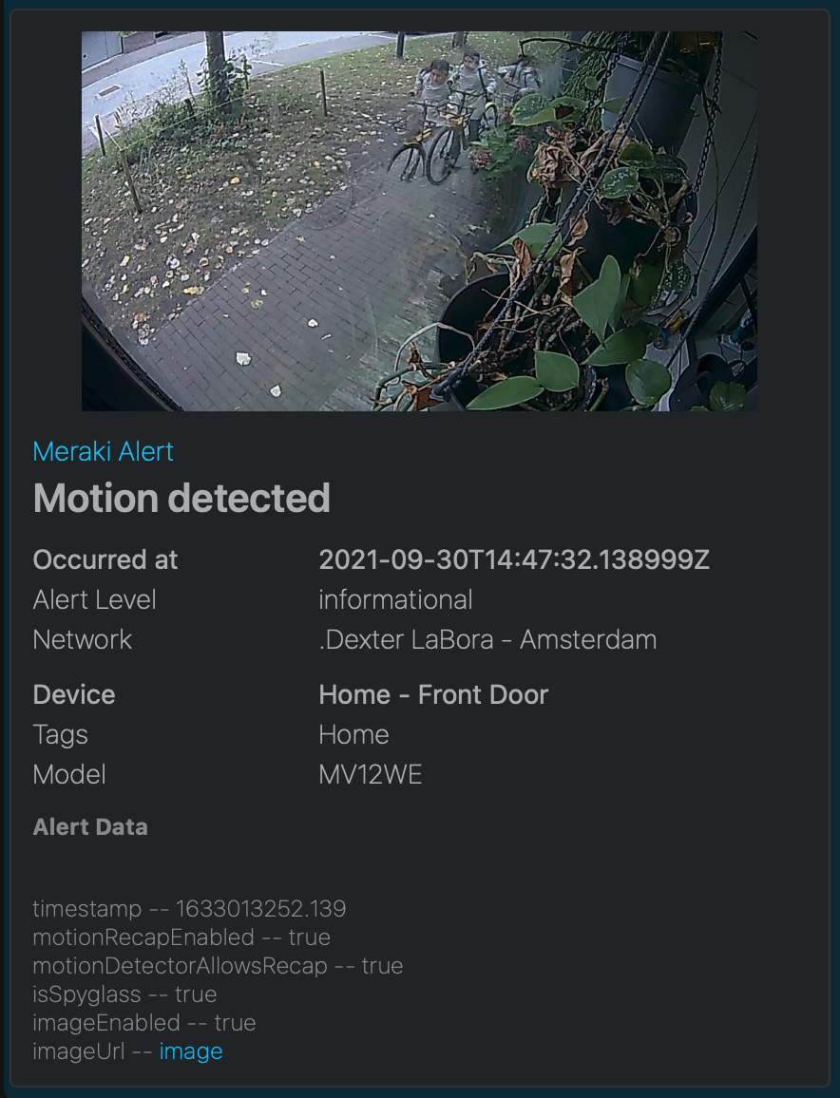
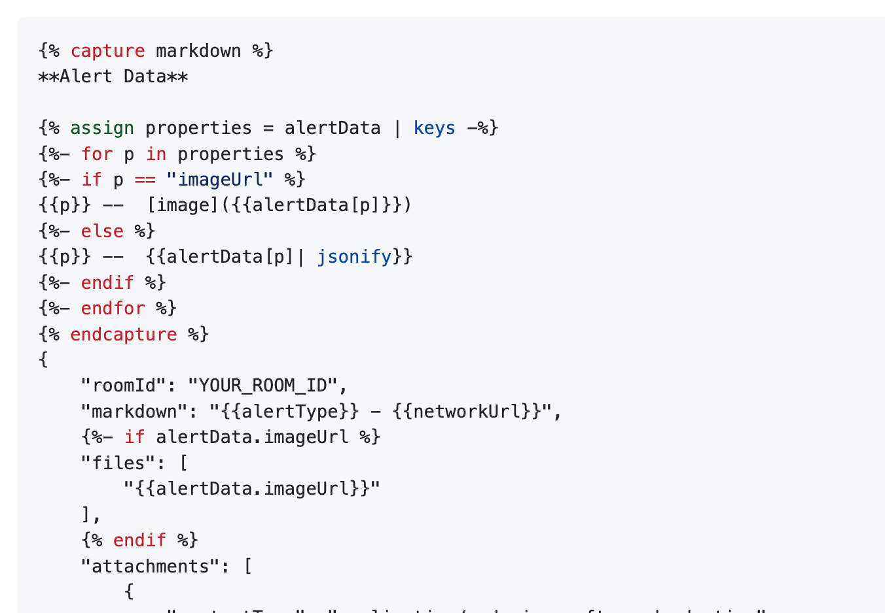
Webhooks + Webex w/ Adaptive Cards
Build amazing looking messages using Adaptive Cards with the Webex API.
Include pictures, rich text and actions with every Meraki alert.
Webex API Resources
API Keys & Authentication
Messages API
Webex Card Designer

Slide 20
API Callbacks
Sometimes an API call takes time… “Ping a device for a few seconds”
“Update 100 network names”
“Cable test 48 switch ports”
Setting a “callback”, allows the API to send the results as a webhook when completed.
https://Meraki.io/api/create-device-live-tools-ping

Slide 21
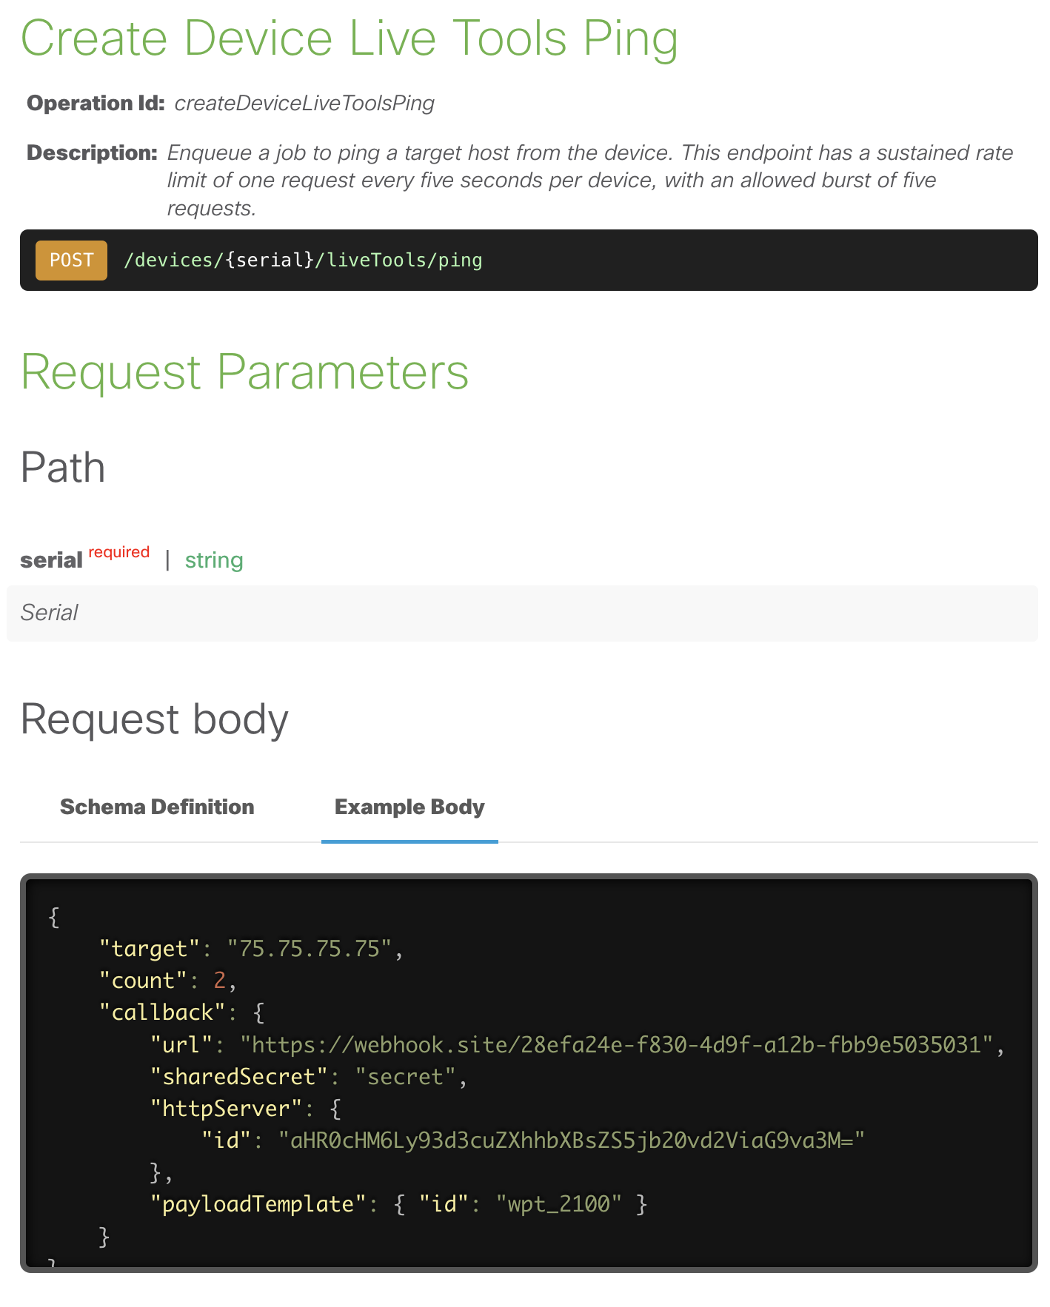
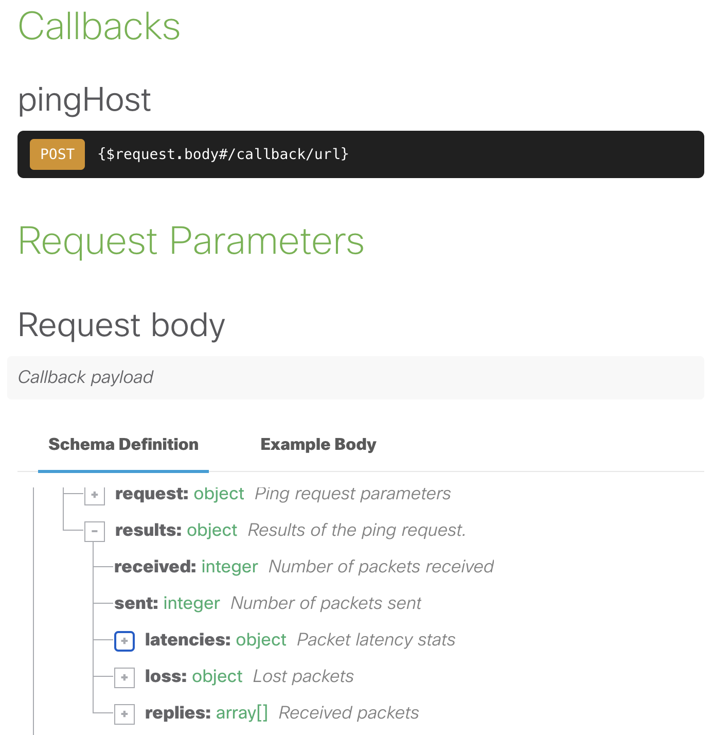
Example API Callbacks
ACL Hit Count | MAC Table
Action Batch | Ping
ARP Table | Ping Device
Blink LEDs | Routing Table
Cable Test | Throughput Test
Create Secure Connect Site | Trace Route
Cycle Port
Look for the new API callback property in supported operations.

Slide 22



Why use callbacks?
Efficiency:
Minimize the need for constant polling
…callbacks can cut the API calls by half, saving both time and resources.
Real-Time Updates:
Stay informed
…with immediate notifications about the status of your operations.
Streamlined Operations:
Automate workflows
…. by using the results from callbacks to trigger actions.

Slide 23
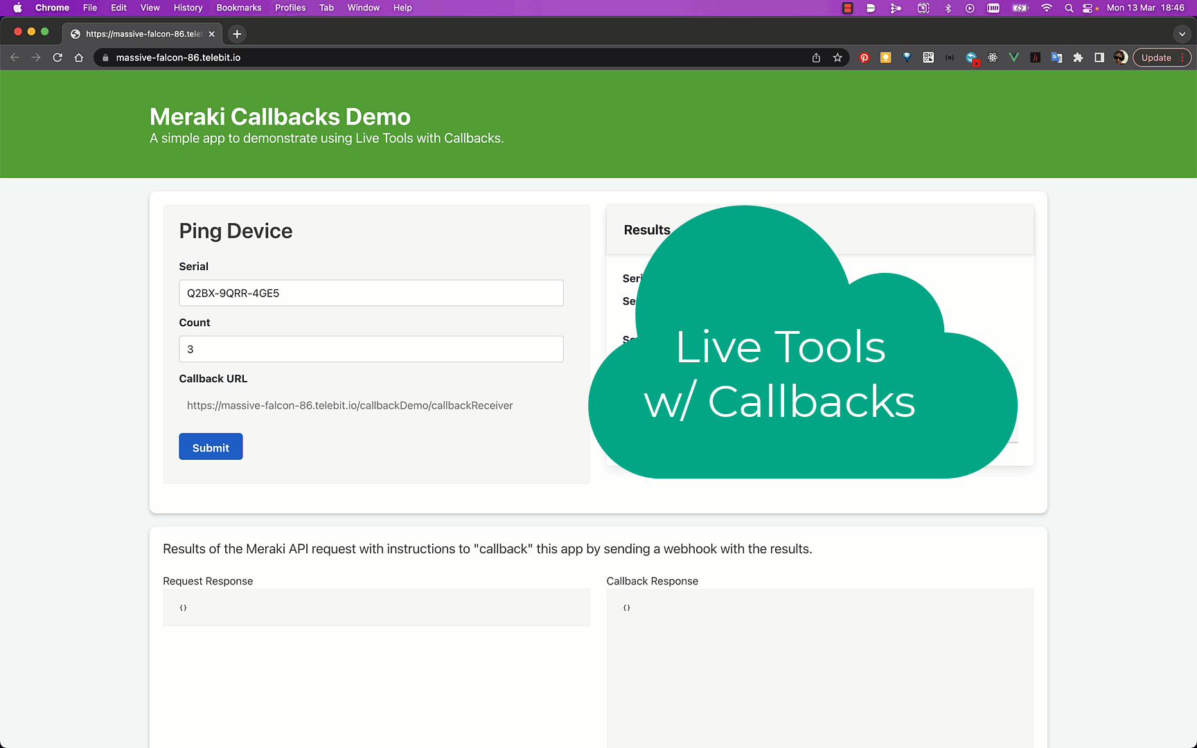

Slide 24

https://github.com/dexterlabora/meraki_webhook_lab
Lab

Slide 25
Appendix

Slide 26
Referenced Resources
Meraki Dashboard API documentation
Meraki Webhook Documentation

Slide 27
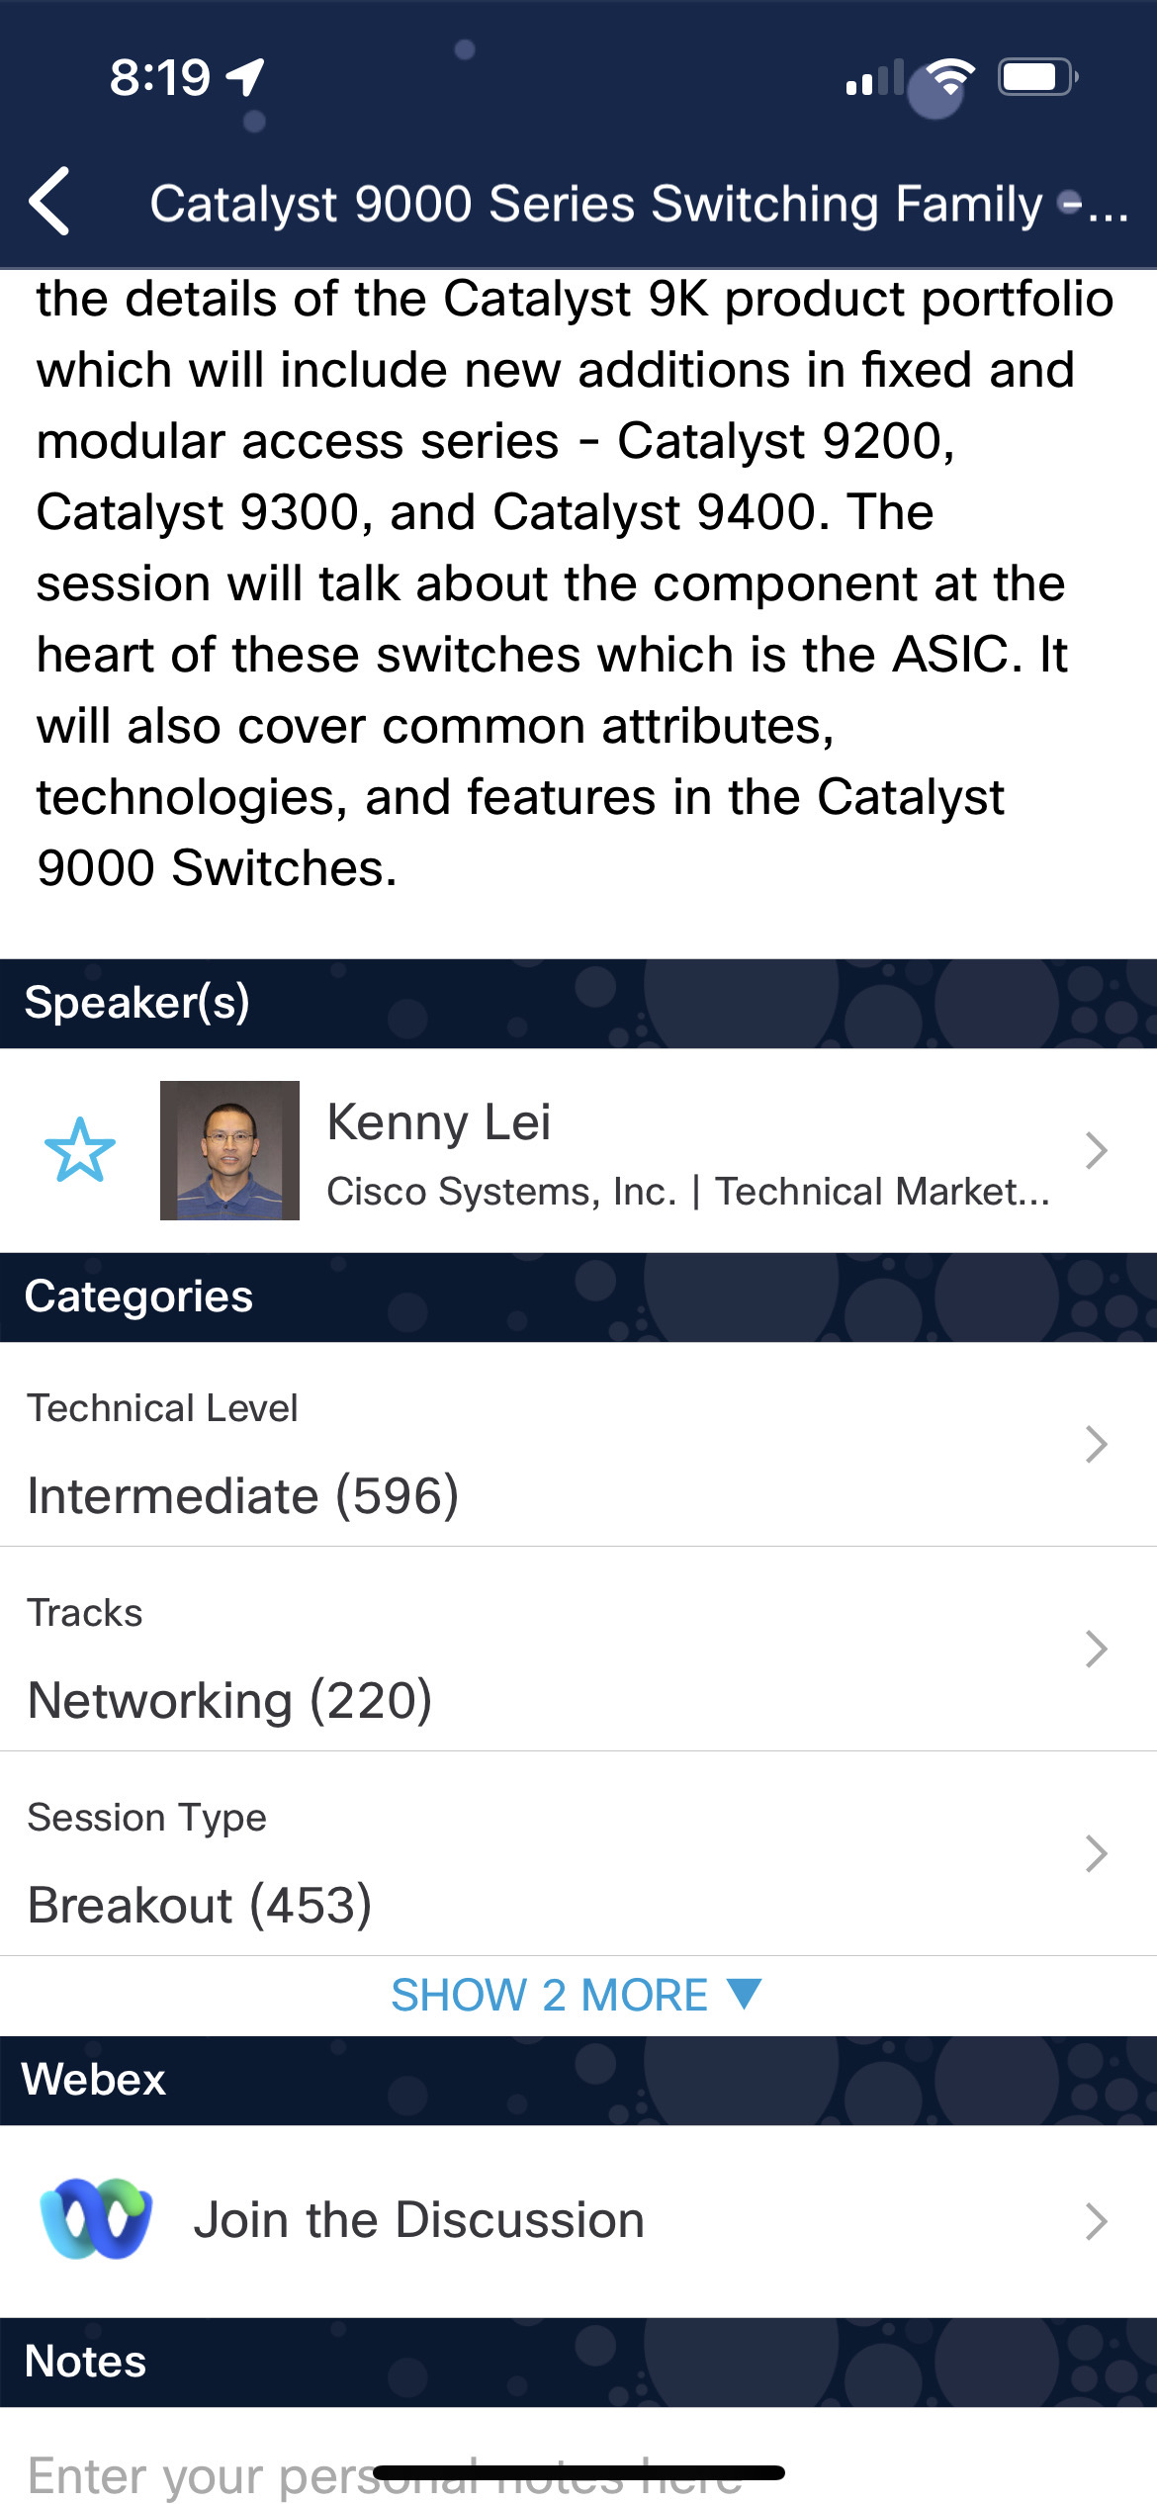
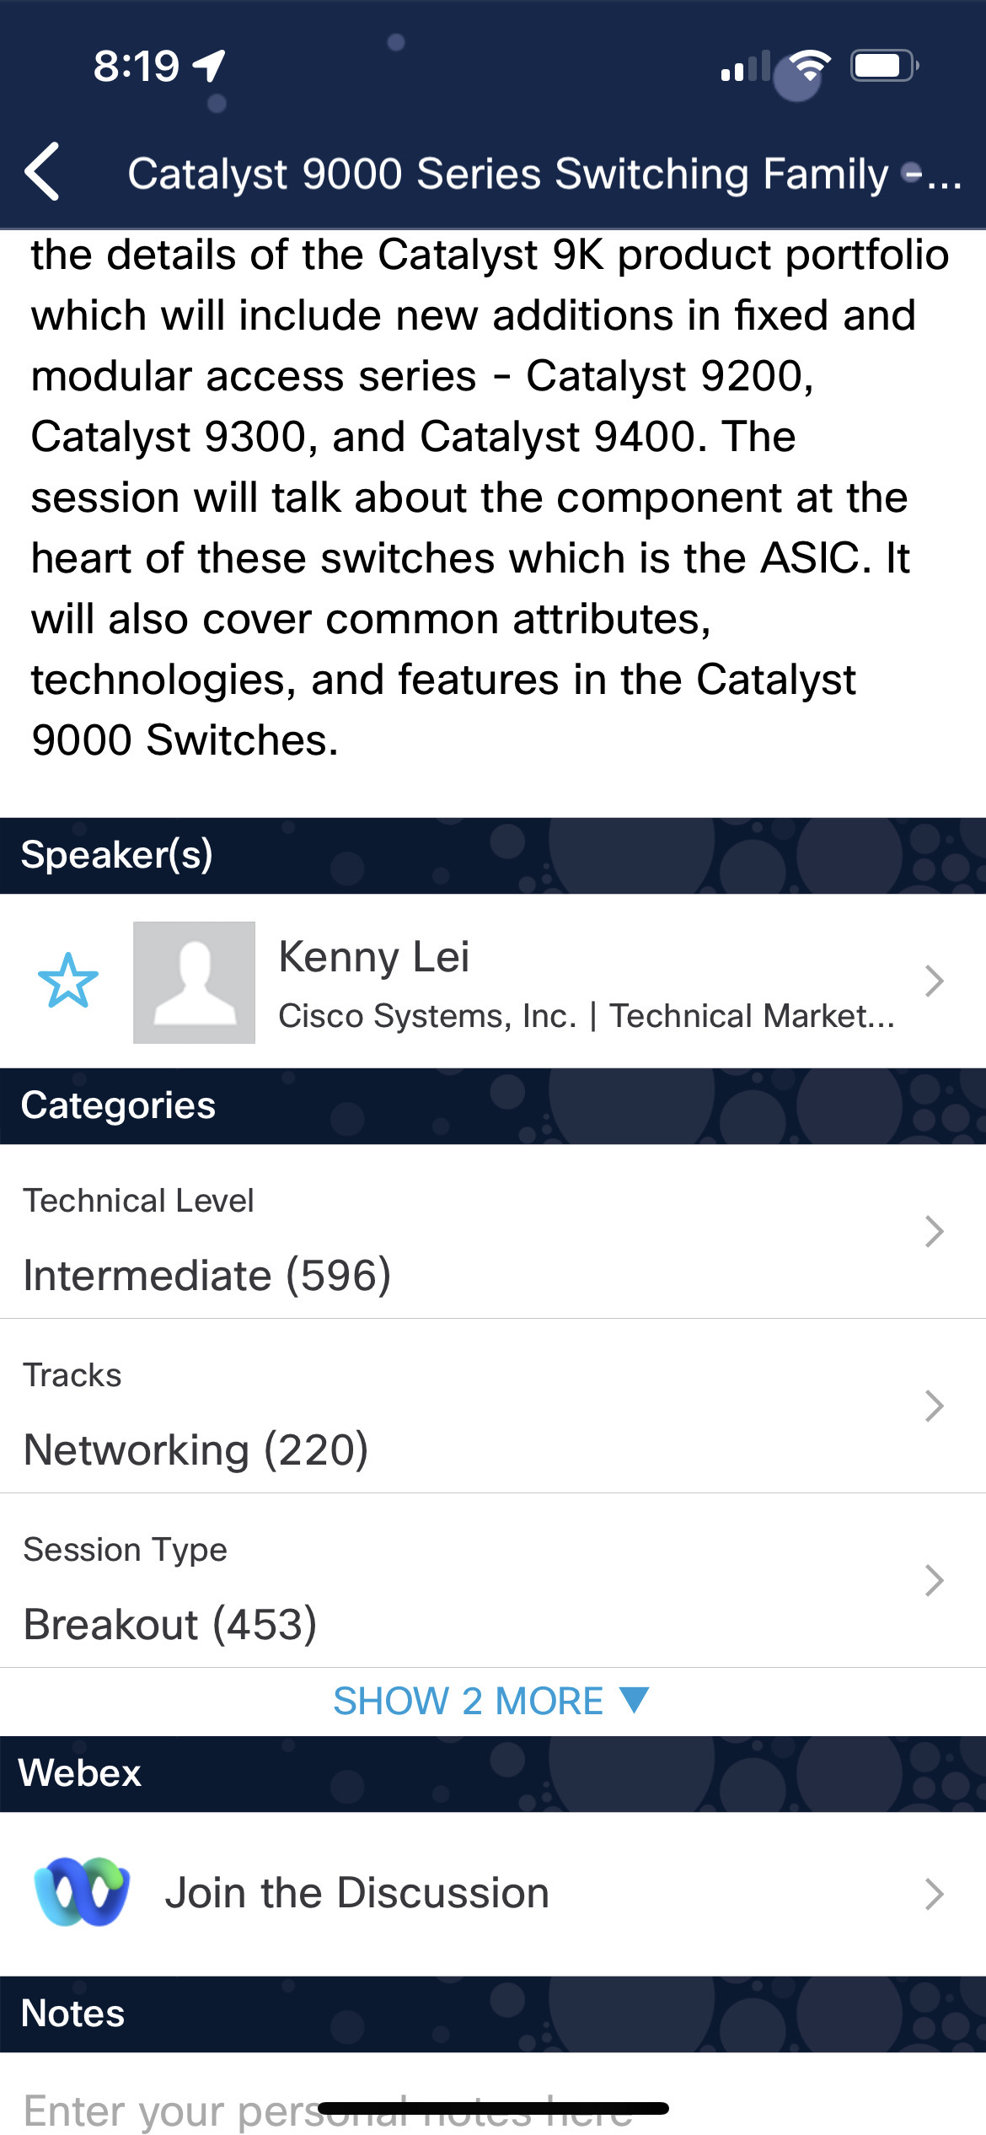

Cisco Webex App
Questions?
Use Cisco Webex App to chat with the speaker after the session
How
1
Find this session in the Cisco Live Mobile App
Click “Join the Discussion”
Install the Webex App or go directly to the Webex space
Enter messages/questions in the Webex space
2
3
4
Enter your personal notes here
Webex spaces will be moderated by the speaker until June 13, 2025.
https://ciscolive.ciscoevents.com/ ciscolivebot/#BRKXXX-xxxx

Slide 28

Complete your session evaluations
Complete a minimum of 4 session surveys and the Overall Event Survey to be entered in a drawing to win 1 of 5 full conference passes to Cisco Live 2026.
Earn 100 points per survey completed and compete on the Cisco Live Challenge leaderboard.
Level up and earn exclusive prizes!
Complete your surveys in the Cisco Live mobile app.

